Slide 1

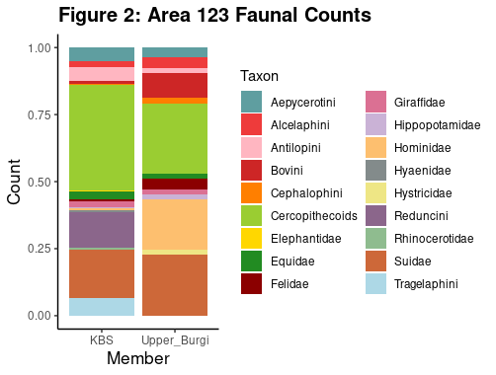
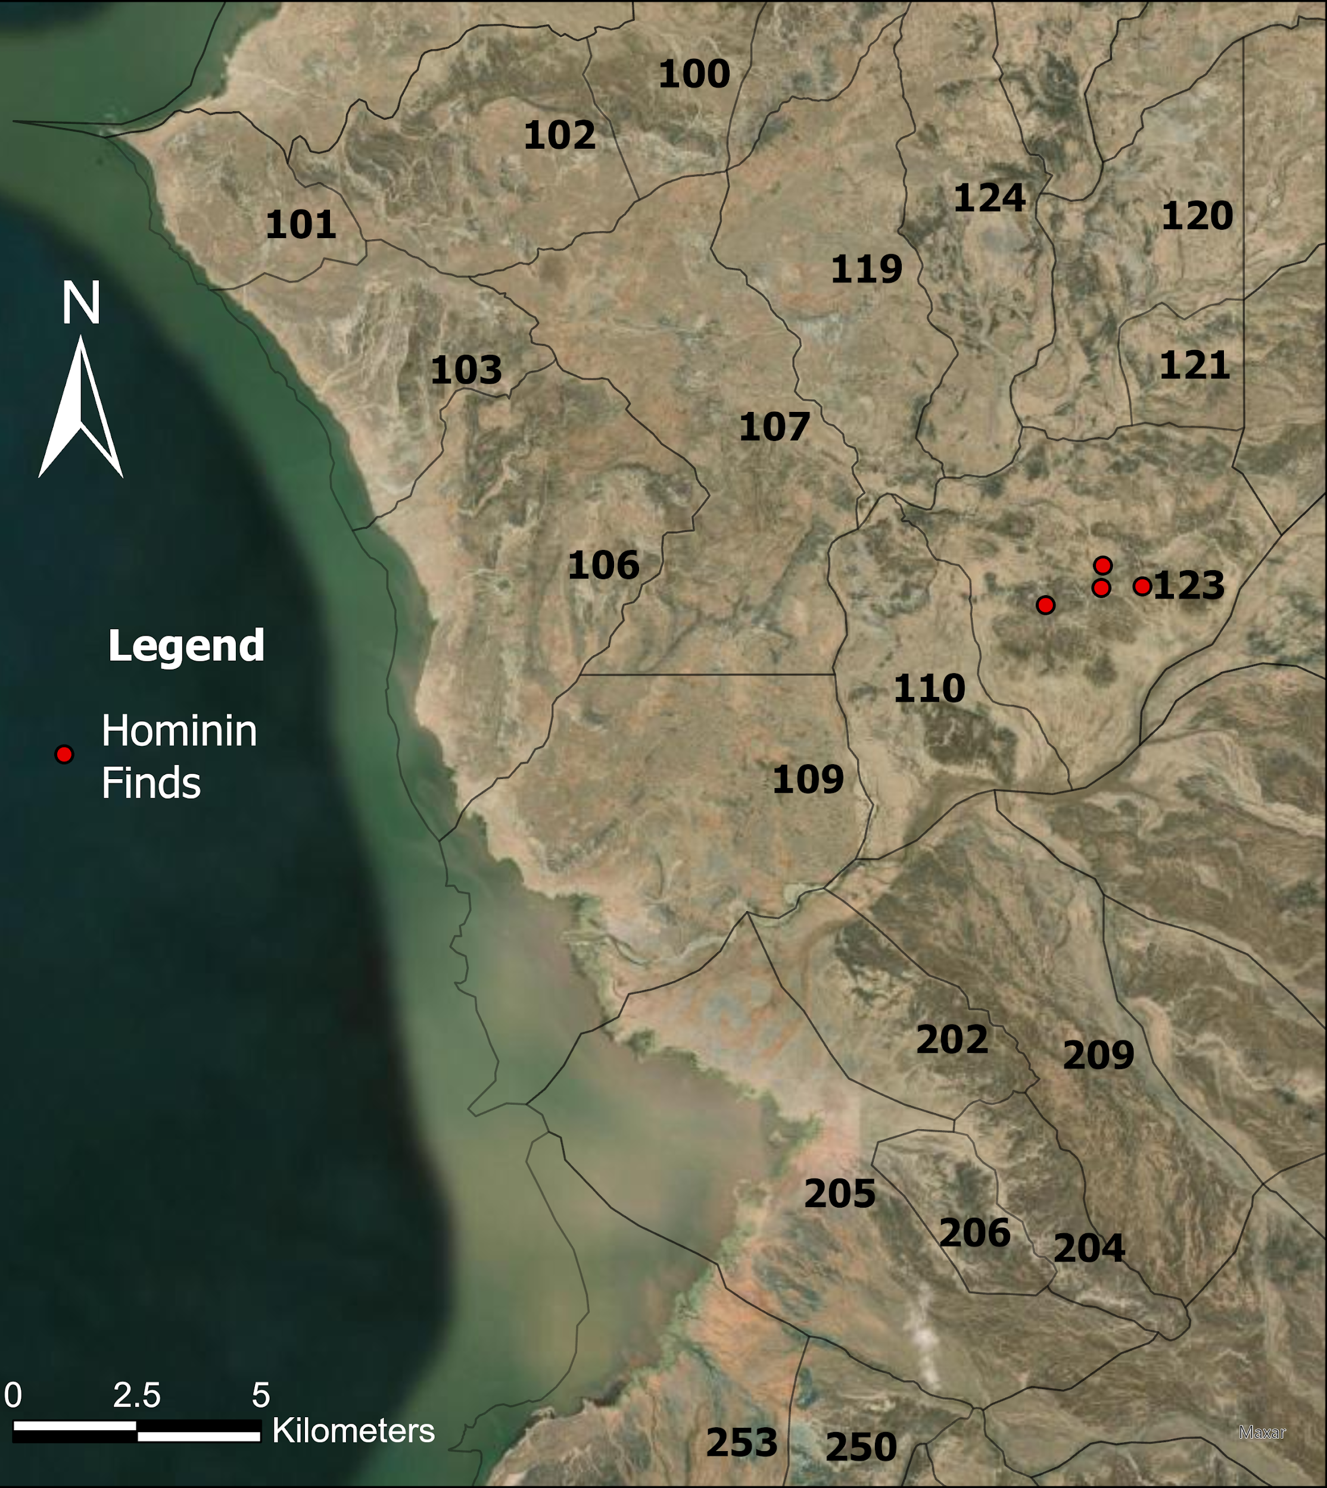
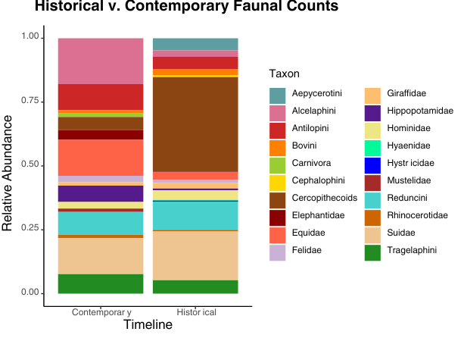
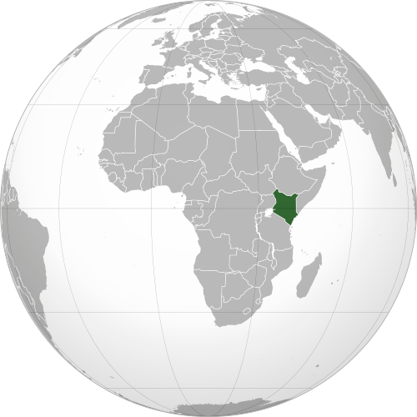

Reassessing the Paleoecological Context of Area 123 at Koobi Fora, East Turkana, Kenya
Saranna Shevalier, SUNY Oneonta, Koobi Fora Field School 2025
Mentor: Sahle Melaku, Master of Science, Department Head and Research Associate Paleontology and Paleoanthropology at National Museum of Ethiopia
Why study Area 123 in the Turkana Basin?
→ Fossils from desired timeline, 3-1 Ma, marking major changes in Hominin evolution
→ Magnificent preservation due to cyclical wet and dry periods (Feibel, 2011).
→ Volcanic activity, presence of dateable tuffs (Phillips, 2023).
→ Large number of Hominin findings, including Homo habilis KNM-ER-1813 (Day et al.,1976) prompts further investigation.
Research questions:
What is the taxonomic composition of Area 123?
How do biases affect interpretations of community structure?
How do patterns of species abundance and diversity vary across the KBS-Upper Burgi Member transition? (2.0 Ma-1.8 Ma)
Results
Statistical Analysis of Findings
KBS (1.8 Ma) vs. Upper Burgi (2.0 Ma) Members:
i. Alpha diversity:
KBS- 1.953602
Burgi- 2.045809
ii. Beta diversity: 0.2 or 20%
iii. Fisher’s exact test: 0.5464
Historical (1970’s) vs Contemporary Collections (2022-2025)
i. Alpha diversity:
1970’s- 2.060926
2020’s- 2.466046
ii. Beta diversity: 0.17 or 17%
iii. Fisher’s exact test: 0.06508
Conclusions and Implications:
i. Alpha → High species richness within all collections
ii. Beta → Relatively low variation in family level taxonomic composition between KBS v. Upper Burgi and Historical v. Contemporary
iii. Fisher’s → No significant difference in relative abundances between KBS v. Upper Burgi, but significant differences in relative abundance between historical and contemporary.
Increase in Tragelphini and Cercopithecoid monkeys → increase in woody cover from Upper Burgi to KBS)
Collection of desired taxa (Hominins and primates) may skew historical data and make ecological interpretations difficult.
Figure 2: Faunal Count, Contains historical analysis of faunal count in Area 123, separated by presence within the Upper Burgi Member(2.0 Ma) vs. the KBS Member(1.87 Ma).
Research
Site
References:
Day, M.H., Leakey, R.E.F., Walker, A.C., and Wood, B.A., 1976. New hominids from East Turkana, Kenya. American Journal of Physical Anthropology. 45(3), pp.369-435.
Feibel, C.S., 2011. A geological history of the Turkana Basin. Evolutionary Anthropology: Issues, News, and Reviews. 20(6), pp.206-216.
Phillips, D., Matchan, E., Gleadow, A., Brown, F., McDougall, I., Cerling, T., Leakey, M., Hergt, J., and Leakey, L., 2023. 40Ar/39Ar eruption ages of Turkana Basin tuffs: millennial scale resolution constraints paleoclimate proxy tuning models and hominin fossil ages. Journal of the Geological Society, pp.jgs2022-171.
Figure 3: Both collections spanning similar timelines, difference in collection strategies between 1970’s-2020’s is reflected as Cercopithecoid monkeys were collected in higher numbers in historical collections.
Acknowledgements:
SRC Grant. Dr. Kaedan O’Brien, KFFS ‘25 Fellowship. Sahle Melaku
Broader Bibliography
Figure 1: Map of collection areas in the Koobi Fora Formation, located in the Turkana Basin of Northern Kenya, East Africa. Hominin elements discovered from Area 123 are indicated by red dots.

